Slide 1
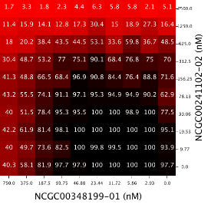
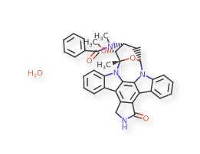
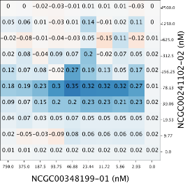
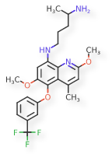
Similar Compounds Show Similar Activities- Is This True for Compound Combinations?
Intern: Sarita Lee
Mentors: Raj Guha & Lu Chen

Slide 2
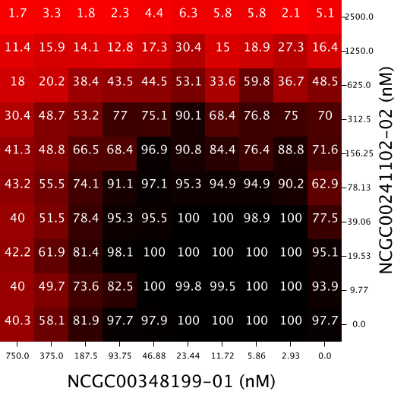
Introduction- Drug Combinations and Synergy
Response Matrix
Drug combinations are used to treat many medical conditions such as: HIV, malaria, and cancer
Sometimes the combined effect of drugs is different than their individual effects
  When it is better: synergism
  When it is the same: additive
  When it is worse: antagonism
Drug Y
Drug X

Slide 3
Introduction- Screening Drug Combinations
Traditionally, screening for drug combinations has been a slow process
Since NCATS has high throughput screening (HTS), data for thousands of drug combinations can be generated quickly
Presnets opportunity to do large scale analysis
Given a response matrix, how do we quantify synergy?
[slide 8 image from ppnt]

Slide 4
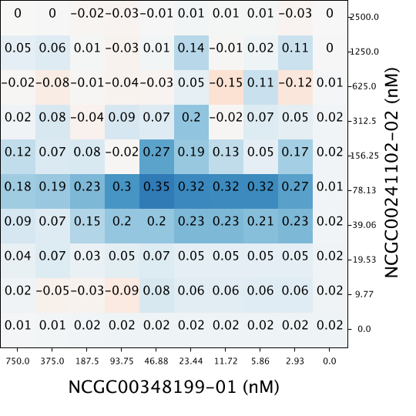
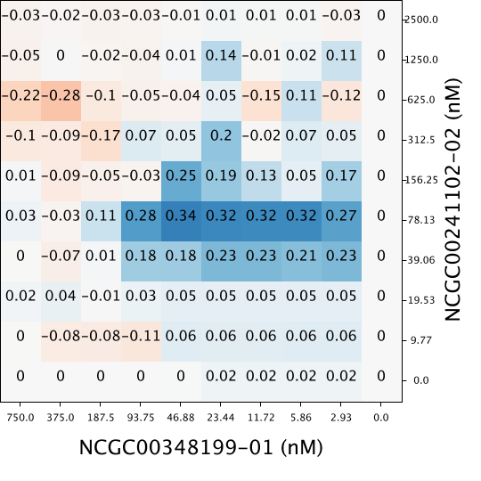
Introduction- Methods to Measure Synergy
Synergy is quantified with respect to a model of additivity
Three Models:
  Highest Single Agent (HSA)
  Bliss Independence Model
  Loewe Additivity Model
Used Bliss Independence Model: convenient and more robust in high throughput setting
Response Matrix
Synergy Matrix-
HSA
Synergy Matrix-
Delta Bliss

Slide 5
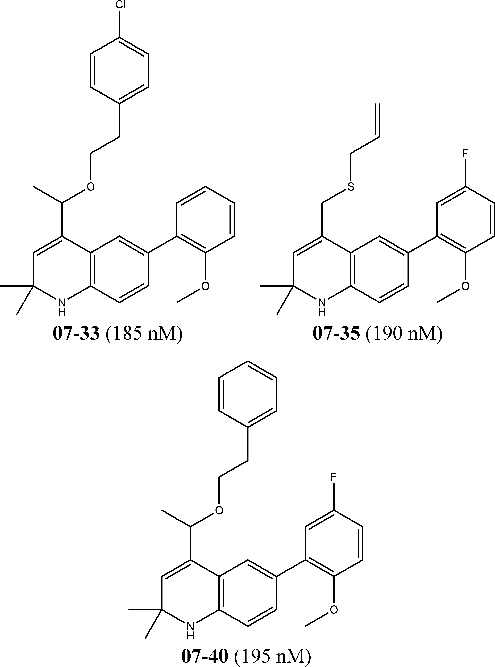
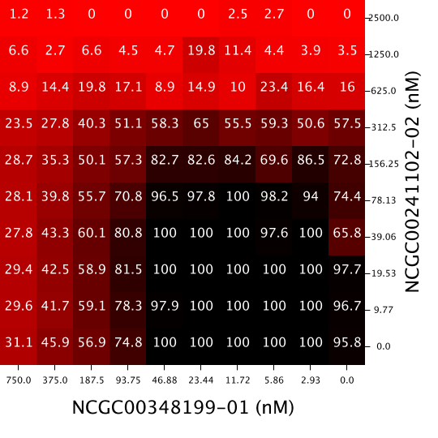
Introduction- Similarity Property Principle
Similarity Property Principle: “similar compounds have similar properties”
Similar Compounds tend to show similar activities (such as IC50)
Dissimilar Compounds tend to show dissimilar activities
Will similar response matrices show similar synergy matrices?
Will similar corresponding compounds in a combination show similar response matrices? Synergy matrices?
[reference]

Slide 6
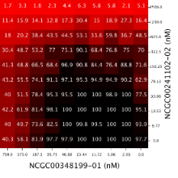
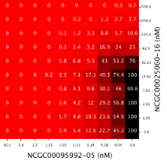

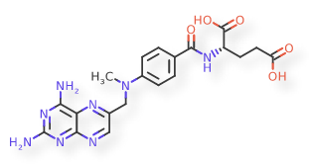
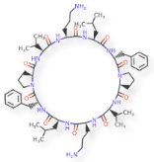
Overarching Questions
Drug Combo A:
Response Matrix
Drug Combo B:
Response Matrix
Question 1: What are metrics to quantify dissimilarity between two responses?
Question 2: Does combination response correlate to synergy? How?
Question 3: Does chemical structure correlate to combination response? Synergy? How?
Question 4: Does dose response correlate to combination response? Synergy? How?
Drug Combo A:
Response Matrix
Drug Combo A:
Delta Bliss Matrix
Drug Combo A:
Compounds
Drug Combo B:
Compounds
Drug Combo A:
Response Matrix
Drug Combo B:
Response Matrix

Slide 7
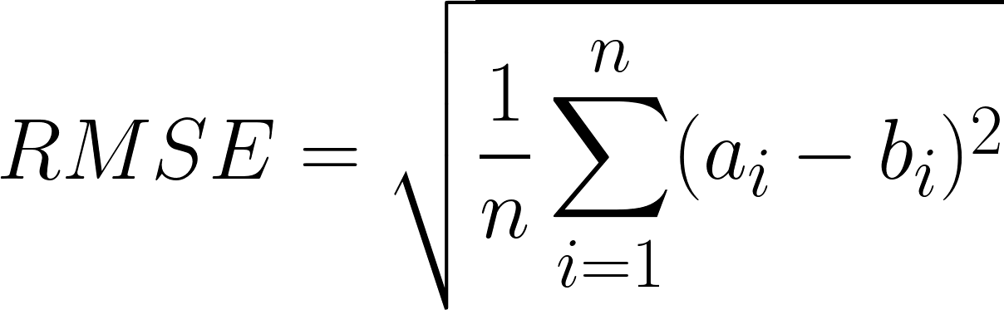
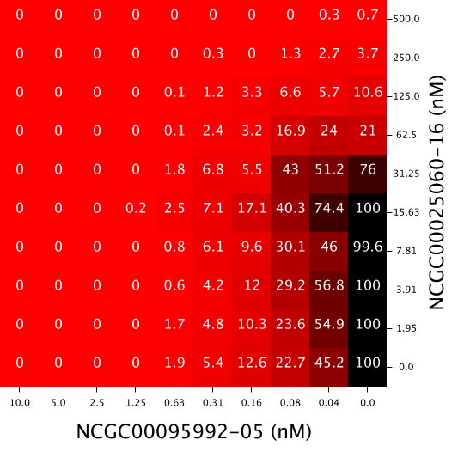
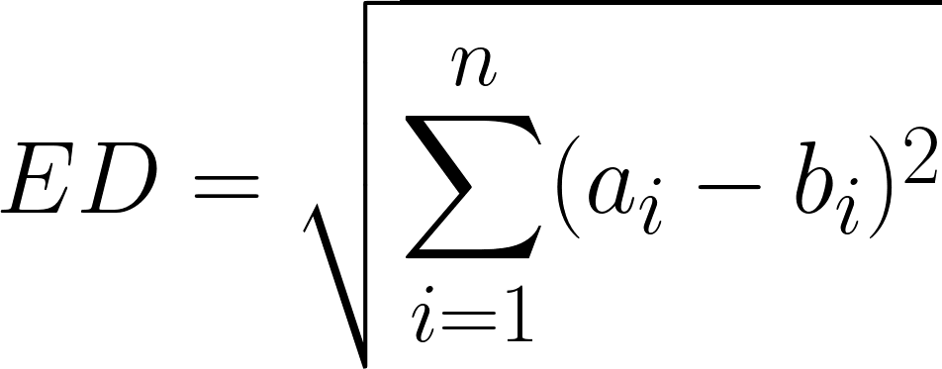
Question 1: Dissimilarity Metrics
Insensitive to Spatial Distribution
Sensitive to Spatial Distribution
1. Root Mean Standard Error (RMSE)
2. Euclidean Distance (ED)
3. Two- Sample Kolmogorov-Smirnov Test (KS Test)
4. Syrjala Test
Drug Combo A
Drug Combo B
Using these four metrics, we computed dissimilarity for all pairs of drug combinations

Slide 8
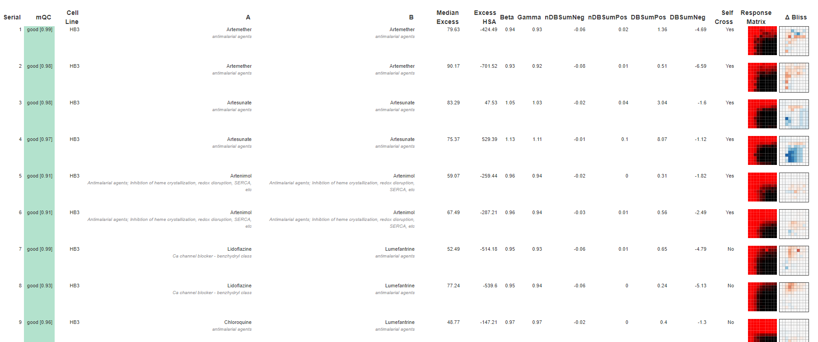
Question 1: Dissimilarity Metrics-
Malaria (strain here from website) AID 1764
(First 9 drug combinations displayed; 480 total in the assay)

Slide 9
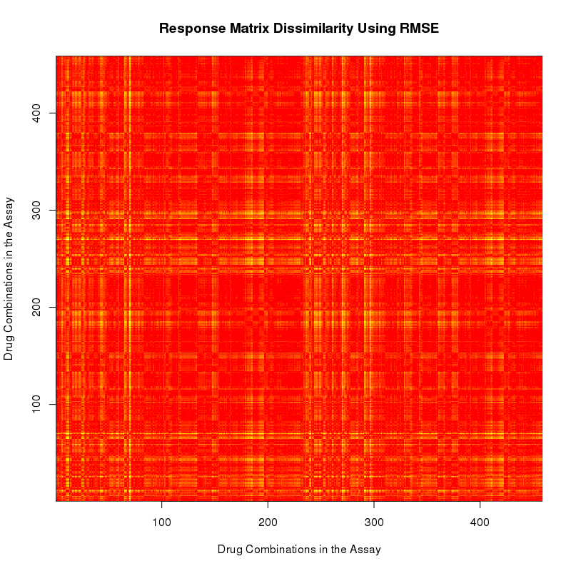
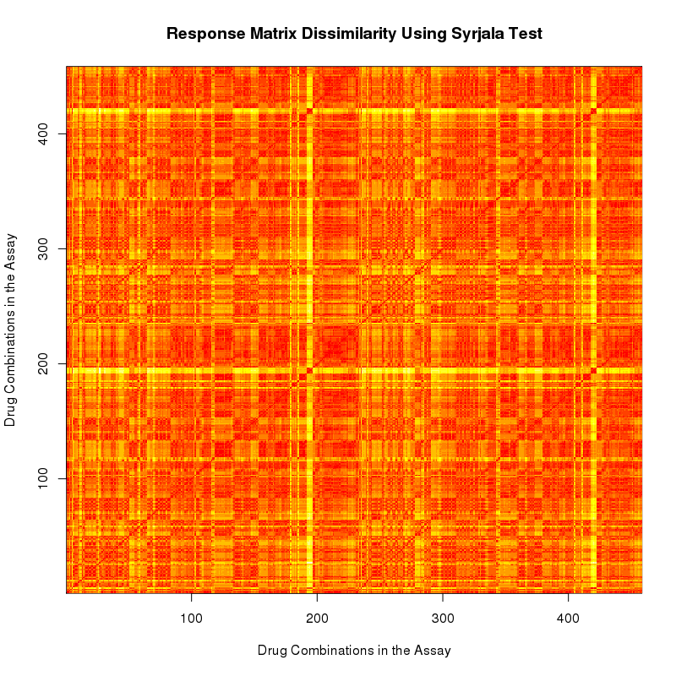
Question 1: Dissimilarity Metrics-
Malaria Assay 1764 Response Matrices
RMSE
Syrjala Test
Red- more similar
Yellow- more dissimilar

Slide 10
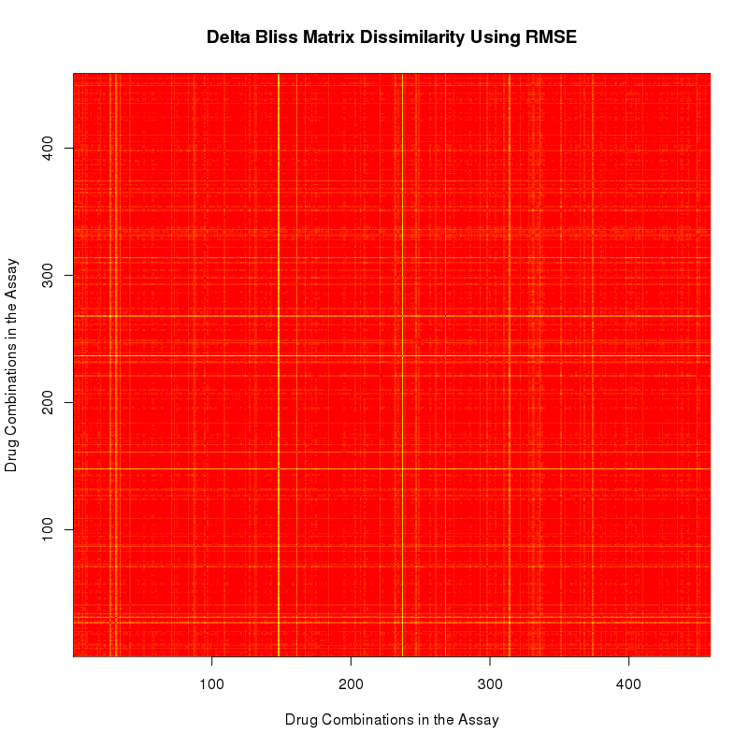
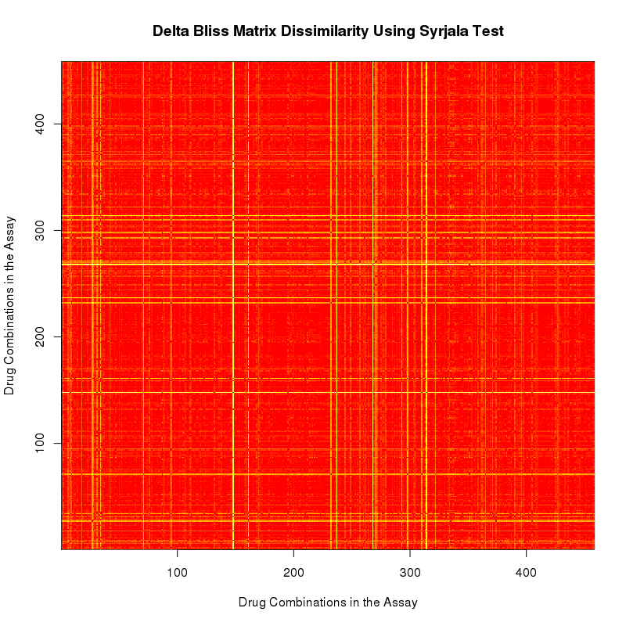
Question 1: Dissimilarity Metrics-
Malaria Assay 1764 Delta Bliss Matrices
RMSE
Syrjala Test

Slide 11
Overarching Questions
Drug Combo A:
Response Matrix
Drug Combo B:
Response Matrix
Question 1: What are metrics to quantify synergy between two responses?
Question 2: Does combination response correlate to synergy? How?
Question 3: Does chemical structure correlate to combination response? Synergy? How?
Question 4: Does dose response correlate to combination response? Synergy? How?
Drug Combo A:
Response Matrix
Drug Combo A:
Delta Bliss Matrix
Drug Combo A:
Compounds
Drug Combo B:
Compounds
Drug Combo A:
Response Matrix
Drug Combo B:
Response Matrix

Slide 12

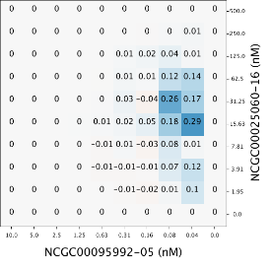
Question 2: Activity Correlated With Synergy
Is there a correlation between the dissimilarity of response surfaces and the dissimilarity of the delta Bliss (synergy) surfaces ?
Drug Combo
A
Drug Combo
A
Drug Combo
B
Drug Combo
B

Slide 13
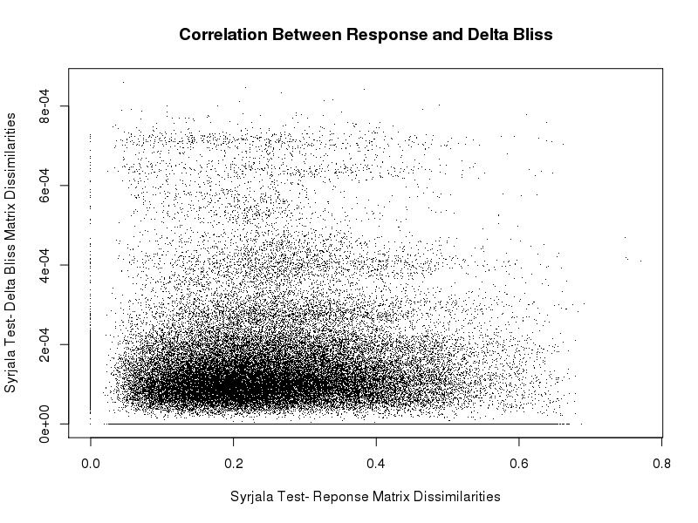
Question 2: Activity Correlated With Synergy-
Malaria Assay 1764
Response Matrix Dissimilarity- Syrjala Test
Delta Bliss Matrix Dissimilarity-
Syrjala Test

Slide 14
[3 parasite lines]

Slide 15
Overarching Questions
Drug Combo A:
Response Matrix
Drug Combo B:
Response Matrix
Question 1: What are metrics to quantify synergy between two responses?
Question 2: Does combination response correlate to synergy? How?
Question 3: Does chemical structure correlate to combination response? Synergy? How?
Question 4: Does dose response correlate to combination response? Synergy? How?
Drug Combo A:
Response Matrix
Drug Combo A:
Delta Bliss Matrix
Drug Combo A:
Compounds
Drug Combo B:
Compounds
Drug Combo A:
Response Matrix
Drug Combo B:
Response Matrix

Slide 16
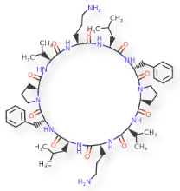
Question 3: Structure Correlated With Response and Synergy
Is there a correlation between the dissimilarity of the compounds and the dissimilarity of the delta bliss (synergy) surfaces?

Slide 17
Question 3: Structure Correlated With Response-
Dissimilarity of Compounds
Step 1. Compare one drug combination to another drug combination
Compare corresponding x agents
Compare corresponding y agents
Average those values
Step 2: Repeat for all pairs of combinations
x agents’ dissimilarity
y agents’ difference
Average dissimilarity

Slide 18
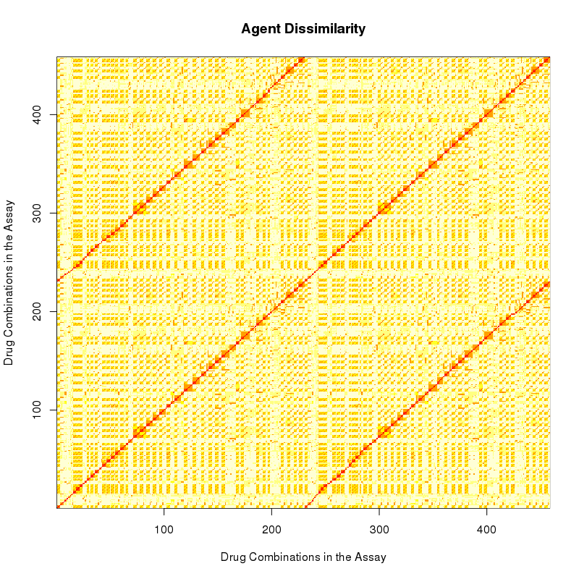
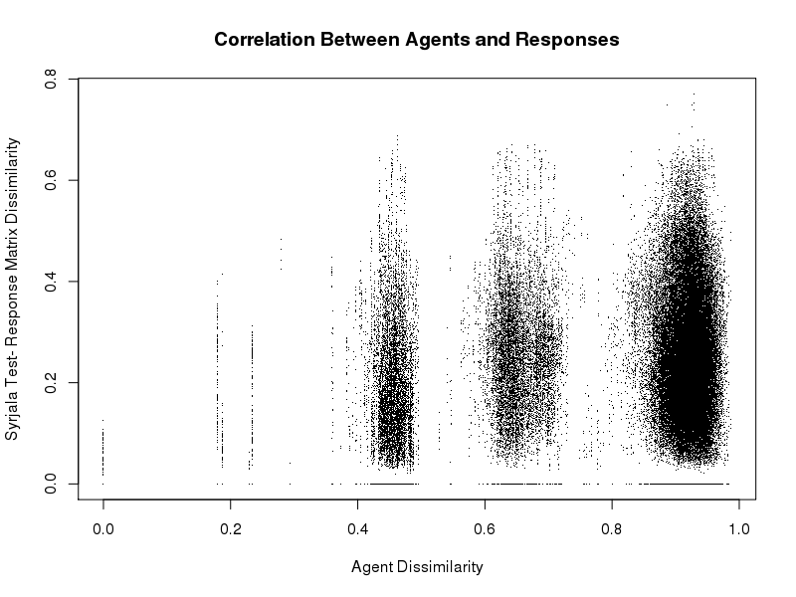
Question 3: Structure Correlated With Response-
Malaria Assay 1764
Agent Dissimilarities
Response Matrix Dissimilarities- Syrjala Test

Slide 19
3 parasite lines

Slide 20
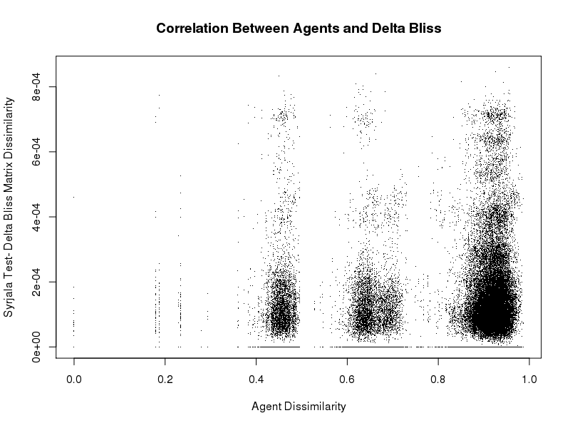
Question 3: Structure Correlated With Synergy-
Malaria Assay 1764
Agent Dissimilarities
Delta Bliss (Synergy) Matrices- Syrjala Test

Slide 21
Overarching Questions
Drug Combo A:
Response Matrix
Drug Combo B:
Response Matrix
Question 1: What are metrics to quantify synergy between two responses?
Question 2: Does combination response correlate to synergy? How?
Question 3: Does chemical structure correlate to combination response? Synergy? How?
Question 4: Does dose response correlate to combination response? Synergy? How?
Drug Combo A:
Response Matrix
Drug Combo A:
Delta Bliss Matrix
Drug Combo A:
Compounds
Drug Combo B:
Compounds
Drug Combo A:
Response Matrix
Drug Combo B:
Response Matrix

Slide 22
Question 4: Dose Response Correlated With Response-
Dissimilarity of Dose Responses
Step 1. Compare one dose response to another dose response using Lin’s CCC
Compare corresponding x agents
Compare corresponding y agents
Average those values
Step 2: Repeat for all combinations
x dose responses’ dissimilarity
y dose responses’ difference
Average dissimilarity
reference

Slide 23
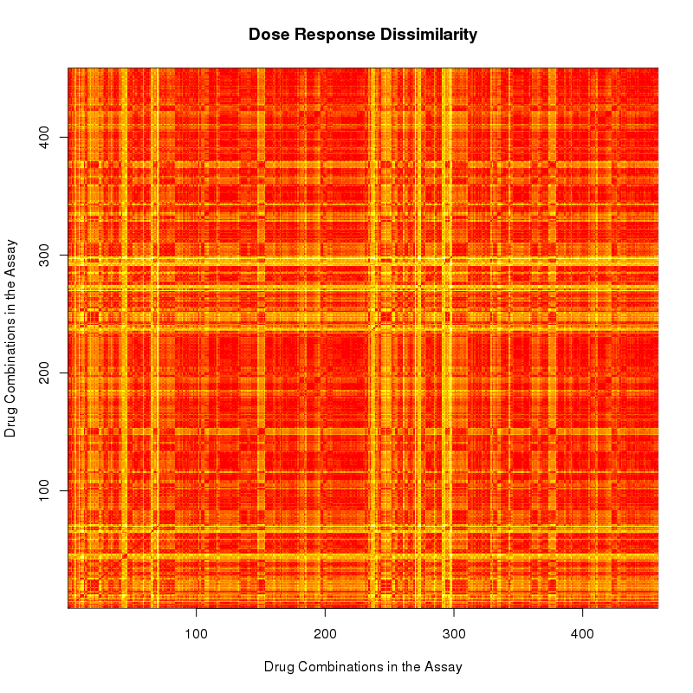
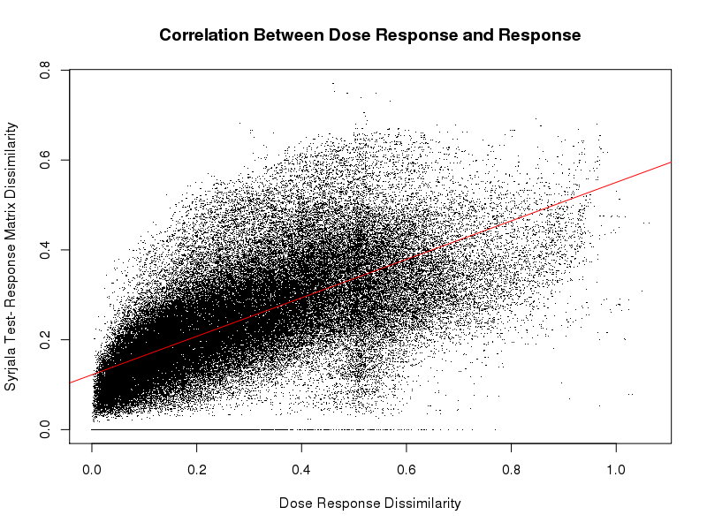
Question 4: Dose Response Correlated With Response-
Malaria Assay 1764
Dose Response Dissimilarities
Response Matrices- Syrjala Test

Slide 24
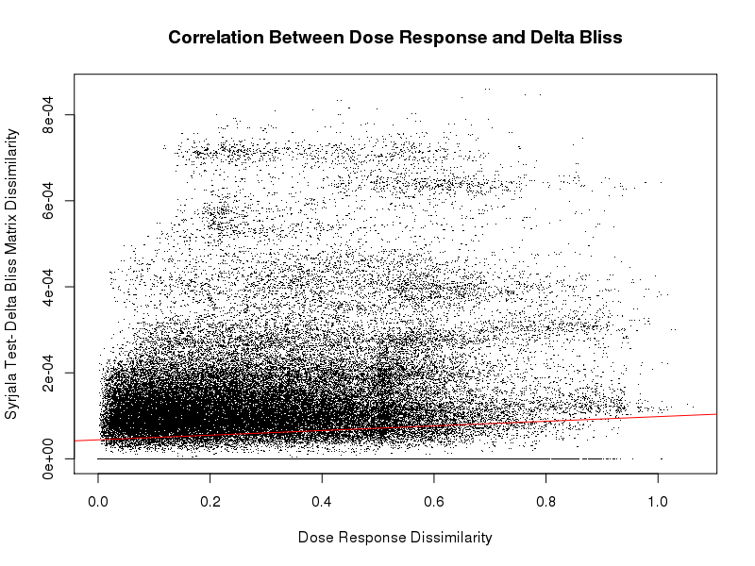
Question 4: Dose Response Correlated With Synergy-
Malaria Assay 1764
Dose Response Dissimilarities
Delta Bliss (Synergy) Matrices- Syrjala Test

Slide 25
Conclusion
The similarity property principle holds for drug combinations, but is likely very weak

